Slide 1

Alcor Foundation
Independent Cryonics Educators
Presented by
Diane M. Cremeens
Director of Membership Services
Alcor Life Extension Foundation
March 24, 2023

Slide 2
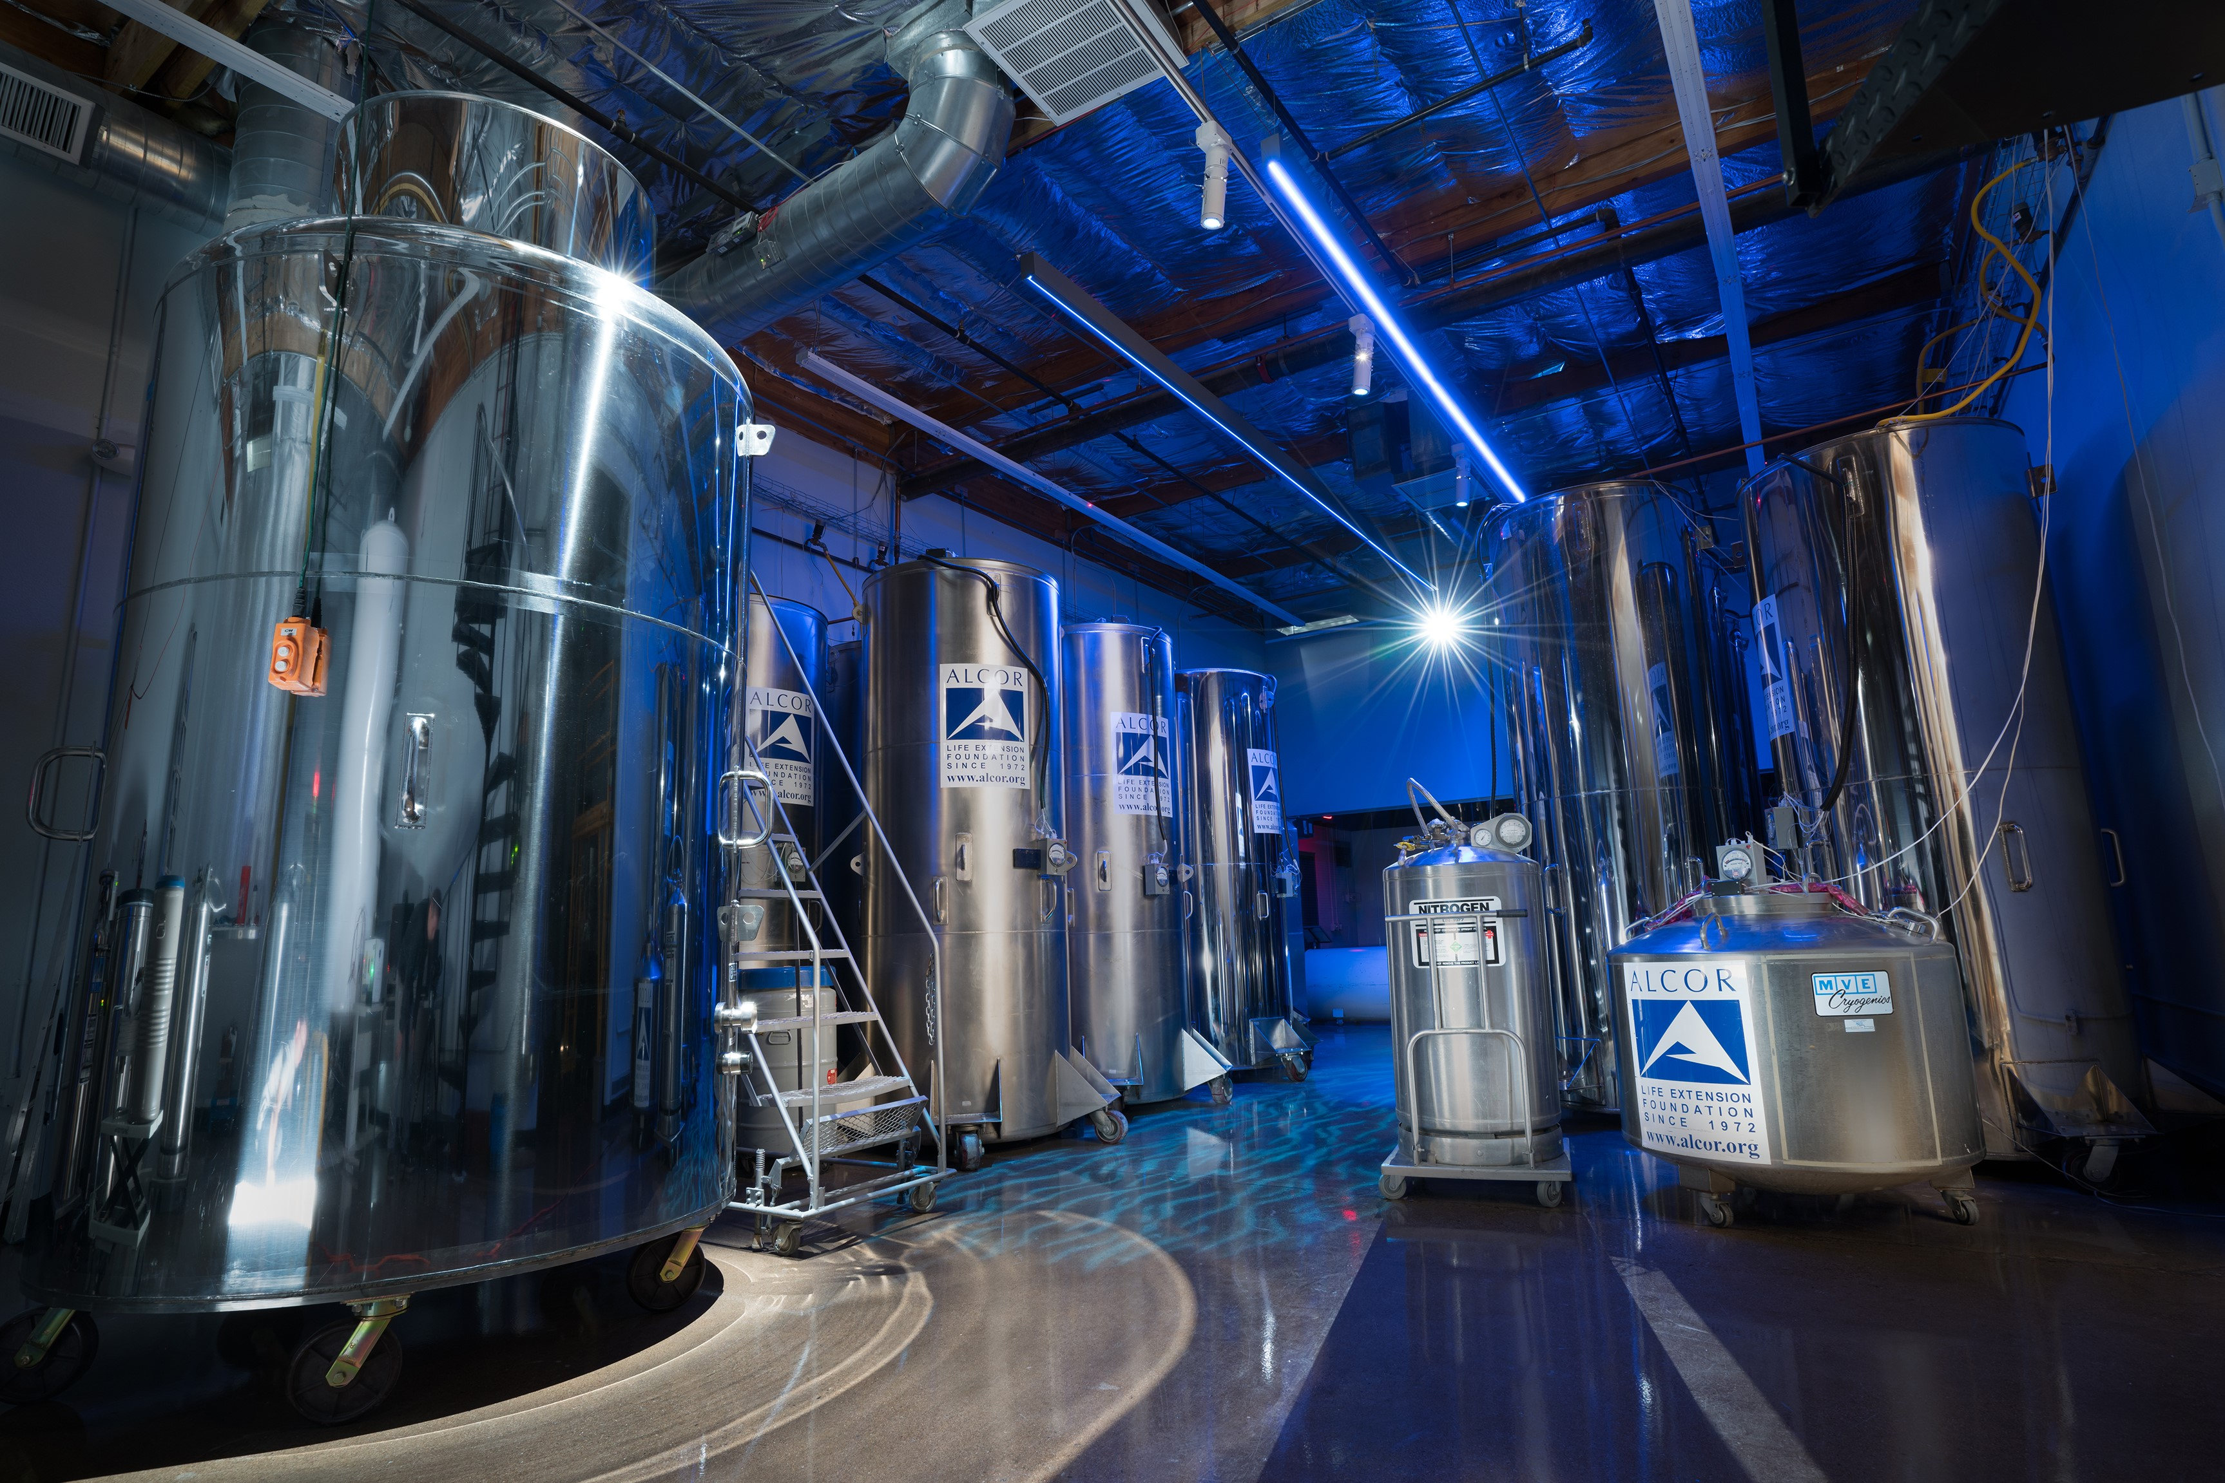
What is Cryonics?
Cryonics (from Greek kryos meaning icy cold) is the extremely low-temperature preservation of humans who can no longer be sustained by contemporary medicine, in the expectation they can be healed in the future using more advanced medical technologies.
Cryonics procedures are initiated when today’s medical technologies and practices can no longer sustain a patient. Cryonics preserves viability by pausing the biological dying process. It is the bridge between pronouncement of legal death and future medical advancements of life-saving measures.

Slide 3
Neuro Vs Whole Body
Alcor Life Extension Foundation makes no recommendation regarding this choice. Members need to educate themselves about these factors involved and make a choice based on their own personal considerations and judgment.
Neurocryopreservation – Is cryopreservation of the brain within the head, based on the premise that the brain is the seat of personal identity and that all other parts of the body can theoretically be regrown around the brain, or head and brain, with sufficiently advanced medical repair technology.
Whole Body Cryopreservation– The cryoprotective perfusion of the whole body with cryoprotectant chemicals, followed by cooling the whole body to liquid nitrogen temperature for long-term preservation.

Slide 4
Funding
Whole Body cryopreservation requires a minimum of $220,000.
Covers the cost for the entire procedure.
The funds are used as follows:
$60,000 for cryopreservation (all procedures up until storage)
$25,000 to the Comprehensive Member Standby (CMS) Fund (pays for standby and response)
$135,000 to the Alcor Care Trust (for long-term care and eventual revival)
Neuro cryopreservation requires a minimum of $80,000.
Covers the cost for the entire procedure.
The funds are used as follows:
$30,000 for cryopreservation (for all procedures up until storage)
$25,000 to the Comprehensive Member Standby (CMS) Fund (pays for standby and response)
$25,000 to the Alcor Care Trust (for long-term care and eventual revival)
For members outside the United States and Canada, the minimum is raised by $10,000. There are also surcharges for cryopreservations arranged by third parties. For details, contact Alcor.

Slide 5
Comprehensive Member Standby (CMS)
When a Member is on their Deathbed, Alcor will send a team to their location and “Standby” them until they are pronounced and then begin the cryonic procedure.
CMS is maintained by an annual fee, currently $200, in addition to membership dues before the member is cryopreserved.
That fee can be waived if the member provides an additional $20,000 in funding. That is typically an economical move for younger members who can obtain life insurance at lower rates. $20,000 in additional life insurance will make little difference to their premium payments.
For older members, this may not be the case, but the additional funding will mean there is some buffer for future increases in minimums.

Slide 6
Funding Methods
There are two approved methods of funding a cryopreservation:
Life insurance and Prepayment.
Approximately 90% of Alcor members use life insurance. This is especially helpful for younger members.
The insurance company must be rated as A- or better by A.M. Best (www.ambest.com).
Alcor recommends a permanent policy such as Whole Life or Universal Index Life Insurance.
Term policies are acceptable, but they must be convertible Term 25 – 30-year policies.
Any alternative funding methods must be presented to and approved by the Alcor Board of Directors.

Slide 7
Types of Alcor Membership
There are two kinds of membership. To be cryopreserved by Alcor a person must be a Cryopreservation Member.
Basic Member: A basic member has signed a membership agreement and pays dues to Alcor and thereby supports the organization and its mission. Members may or may not intend to be cryopreserved. They may want to support the organization without having personal plans to be cryopreserved. They may still be thinking about whether to be cryopreserved and/or are working on their funding.
Cryopreservation Member: A cryopreservation member has all the above benefits plus full legal and financial arrangements for cryopreservation. The funding covers the entire process, from standby, stabilization, and transport, through cryoprotectant perfusion, to long-term storage, and finally to eventual repair and revival.

Slide 8
Becoming an Alcor Member
To apply for basic or cryopreservation membership, use this link: https://alcorfoundation.my.site.com/membership/s/login/SelfRegister
They will need to create their Member portal with a password
Complete the on-line application. Agreements will be emailed when completed.
There is a $300 Application Fee for cryopreservation applicants.
Calculating age-based dues: The annual age-based dues schedule is as follows:
-$60 per minor child under 18 years old
-$200 for 18-year-olds signing a new membership agreement
-(Current Age) x (Annual Dues Multiplier – $15 currently)
Agreements are e-signable using DocuSign.
Due to current law two contracts will need to be printed and signed with two witnesses: The Last Will and Testament, and the Consent for Cryopreservation. The Last Will is the only contract that will need to be notarized, except in California.
Once signup is complete, the cryopreservation member will receive an approval packet which will contain their Alcor Emergency Alert ID Tags, Wallet Card, and other new member information.

Slide 9
Pet Cryopreservation
Alcor offers pet cryopreservation. We don’t want pets to come back in the future with no one to care for them, so pet cryopreservation is only for Alcor cryopreservation members. Basic Membership (rather than cryopreservation membership) is sufficient. We understand that y0u may want to preserve pets before you are able to complete your own arrangements.
Pricing - The storage component of prices depends on size –That’s why there is a big difference in cost between a cat Neurocryopreservation and a Whole Body, large dog cryopreservation. The price includes a contribution to the Patient Care Trust which funds long-term storage. Contact Alcor for pricing.
Types of Cryopreservation
Straight Freeze is the most common option for pets because most of our members do not find it easy to bring their pets to Alcor while the latter are still living. Upon arrival at the Alcor facility, your pet will undergo controlled cooling to liquid nitrogen temperature before being placed in long-term storage.
Perfusion includes the cost of euthanasia at the Alcor facility, and the procedure is done by a veterinary surgeon. Pets can be perfused with cryoprotectant immediately after death, which nearly eliminates ischemia and rapidly cools the brain.
  An appointment for perfusion must be made in advance and the pet must be brought to Scottsdale. Field procedures, done outside of our facility, are not available at this time.
  Apart from storage, the other major cost element is for preparation of the pet for cryopreservation. If you want your pet to be perfused with cryoprotectant to provide a potentially much higher quality of preservation, the cost will be higher. This covers euthanasia, the supplies, setup, and perfusion team.

Slide 10

Thank You

